Slide 1
CS 7643: Deep Learning
Topics:
Computational Graphs
Notation + example
Computing Gradients
Forward mode vs Reverse mode AD
Dhruv Batra
Georgia Tech

Slide 2
Administrativia
No class on Tuesday next week (Sep 12)
HW0 solutions posted

Slide 3
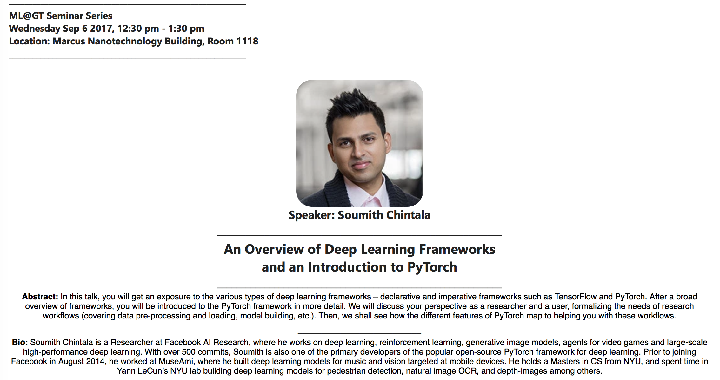
Invited Talk #1
Note: Change in time: 12:30-1:30pm (Lunch at Noon)

Slide 4
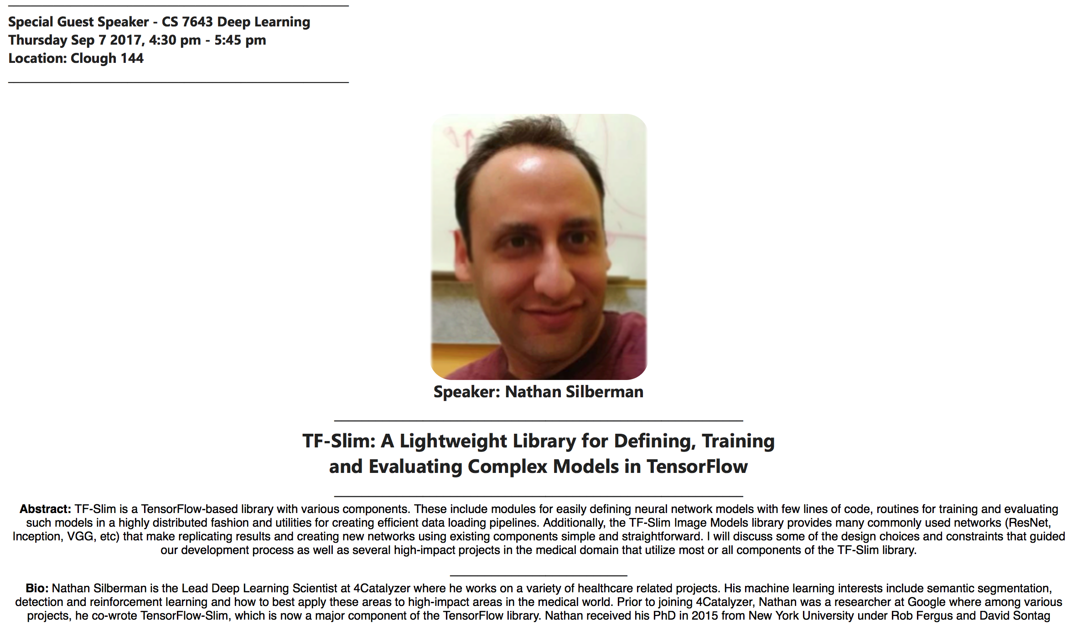
Invited Talk #2

Slide 5
Project
Goal
Chance to try Deep Learning
Combine with other classes / research / credits / anything
You have our blanket permission
Extra credit for shooting for a publication
Encouraged to apply to your research (computer vision, NLP, robotics,…)
Must be done this semester.
Main categories
Application/Survey
Compare a bunch of existing algorithms on a new application domain of your interest
Formulation/Development
Formulate a new model or algorithm for a new or old problem
Theory
Theoretically analyze an existing algorithm

Slide 6
Project
Deliverables:
No formal proposal document due
Consider talking to your TAs
Final Poster Session
(tentative): Week of Nov 27.
Questions/support/ideas
Stop by and talk to TAs
Teaming
Encouraged to form teams of 2-3.

Slide 7



TAs
Michael Cogswell
3rd year CS PhD student
http://mcogswell.io/
Abhishek Das
2nd year CS PhD student
http://abhishekdas.com/
Zhaoyang Lv
3rd year CS PhD student
https://www.cc.gatech.edu/~zlv30/

Slide 8
Paper Reading Intuition: Multi-Task Learning
Task 1
Task Layers
Task 2
Task Layers
data
Shared Layer 1
Shared Layer 2
…
…
Shared Layer N
...
Task Layers
Task N

Slide 9

Paper Reading Intuition: Multi-Task Learning
Paper 1
Task Layers
Paper 2
Task Layers
data
Shared Layer 1
Shared Layer 2
…
…
Shared Layer N
...
Task Layers
Paper 6

Slide 10
Paper Reading Intuition: Multi-Task Learning
Paper 1
Task Layers
Paper 2
Task Layers
data
Shared Layer 1
Shared Layer 2
…
…
Shared Layer N
...
Lectures
Task Layers
Paper 6

Slide 11
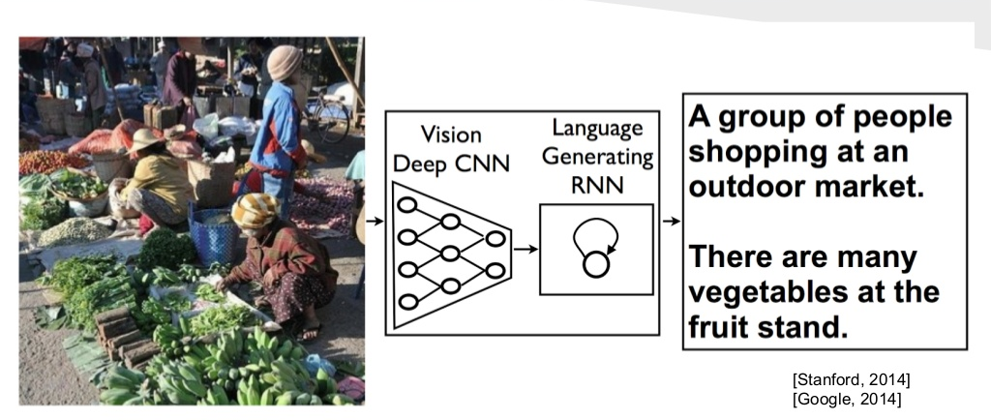
Paper Reading Intuition: Multi-Task Learning
Paper 1
Task Layers
Paper 2
Task Layers
data
Shared Layer 1
Shared Layer 2
…
…
Shared Layer N
...
Lectures
Paper of the Day
Task Layers
Paper 6

Slide 12
Paper Reviews
Length
200-400 words.
Due: Midnight before class on Piazza
Organization
Summary:
What is this paper about? What is the main contribution? Describe the main approach & results. Just facts, no opinions yet.
List of positive points / Strengths:
Is there a new theoretical insight? Or a significant empirical advance? Did they solve a standing open problem? Or is a good formulation for a new problem? Or a faster/better solution for an existing problem? Any good practical outcome (code, algorithm, etc)? Are the experiments well executed? Useful for the community in general?
List of negative points / Weaknesses:
What would you do differently? Any missing baselines? missing datasets? any odd design choices in the algorithm not explained well? quality of writing? Is there sufficient novelty in what they propose? Has it already been done? Minor variation of previous work? Why should anyone care? Is the problem interesting and significant?
Reflections
How does this relate to other papers we have read? What are the next research directions in this line of work?

Slide 13
Presentations
Frequency
Once in the semester: 5 min presentation.
Expectations
Present details of 1 paper
Describe formulation, experiment, approaches, datasets
Encouraged to present a broad picture
Show results; demo code if possible
Please clearly cite the source of each slide that is not your own.
Meet with TA 1 week before class to dry run presentation
Worth 40% of presentation grade

Slide 14
Recap of last time

Slide 15
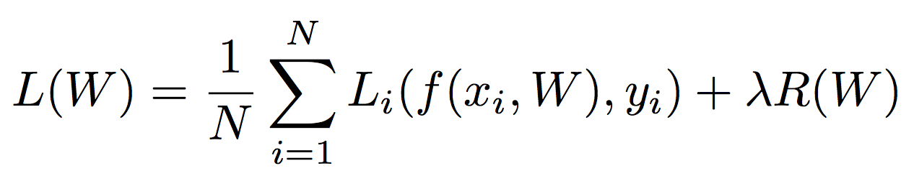
Data loss: Model predictions should match training data
Regularization: Model should be “simple”, so it works on test data
Occam’s Razor:
“Among competing hypotheses, the simplest is the best”
William of Ockham, 1285 - 1347
Slide Credit: Fei-Fei Li, Justin Johnson, Serena Yeung, CS 231n
Notes:
William of Ockham (/ˈɒkəm/; also Occam, from Latin: Gulielmus Occamus;^{[1][2]} c. 1287 – 1347) was an EnglishFranciscan friar and scholastic philosopher and theologian, who is believed to have been born in Ockham, a small village in Surrey.^{[3]} He is considered to be one of the major figures of medieval thought and was at the centre of the major intellectual and political controversies of the fourteenth century. He is commonly known for Occam's razor, the methodological principle that bears his name, and also produced significant works on logic, physics, and theology. In the Church of England, his day of commemoration is 10 April.^{[4]}

Slide 16
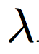
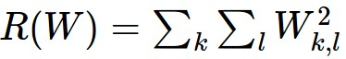
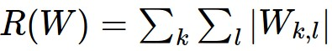
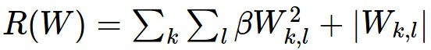
Regularization
= regularization strength
(hyperparameter)
In common use:
L2 regularization
L1 regularization
Elastic net (L1 + L2)
Dropout (will see later)
Fancier: Batch normalization, stochastic depth
Slide Credit: Fei-Fei Li, Justin Johnson, Serena Yeung, CS 231n

Slide 17
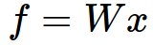
Neural networks: without the brain stuff
(Before) Linear score function:
Slide Credit: Fei-Fei Li, Justin Johnson, Serena Yeung, CS 231n
Notes:
Have been using linear score function as running example of function to optimize

Slide 18
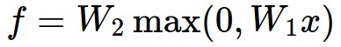
Neural networks: without the brain stuff
(Before) Linear score function:
(Now) 2-layer Neural Network
Slide Credit: Fei-Fei Li, Justin Johnson, Serena Yeung, CS 231n
Notes:
Instead of using single linear transformation, stack 2 together, get 2-layer network

Slide 19
Neural networks: without the brain stuff
(Before) Linear score function:
(Now) 2-layer Neural Network
x
h
W1
W2
s
3072
100
10
Slide Credit: Fei-Fei Li, Justin Johnson, Serena Yeung, CS 231n
Notes:
First have W1*x, then nonlinear function, then second linear layer
More broadly speaking, NN are class of functions where simpler functions are stacked on top of each other in a hierarchical way to make up a more complex, nonlinear function. Have multiple stages of hierarchical computation.

Slide 20
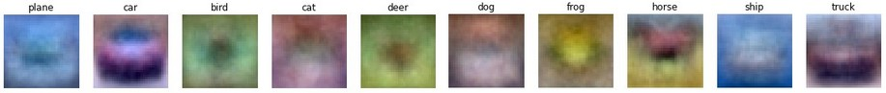
Neural networks: without the brain stuff
(Before) Linear score function:
(Now) 2-layer Neural Network
x
h
W1
W2
s
3072
100
10
Slide Credit: Fei-Fei Li, Justin Johnson, Serena Yeung, CS 231n
Notes:
Biological inspirations to neurons in brain that we’ll discuss later
Looking at it mathematically first, one thing this can help solve, is if we look back to our linear score function, each row of W corresponded to a template
Problem that there can be only one template per class, can’t look for multiple modes
Now intermediate layers can represent anonymous templates that later get recombined
Intermediate layers anonymous templates that get recombined. solves mode problems

Slide 21
Neural networks: without the brain stuff
(Before) Linear score function:
(Now) 2-layer Neural Network
or 3-layer Neural Network
Slide Credit: Fei-Fei Li, Justin Johnson, Serena Yeung, CS 231n
Notes:
Can stack more of these layers to get deeper networks, where the term deep NN comes from

Slide 22
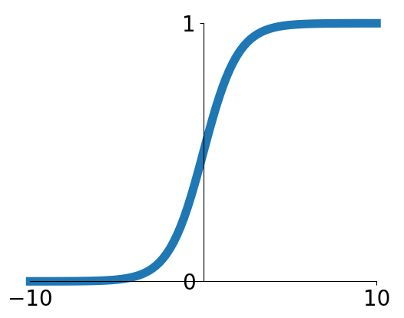
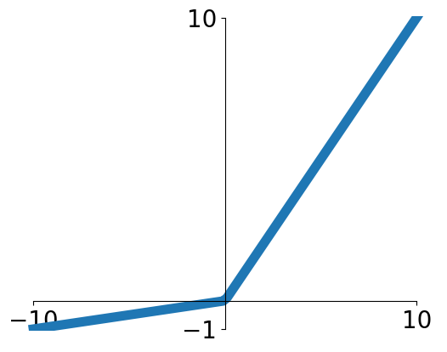
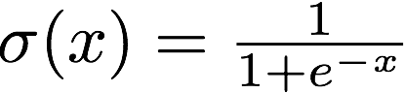
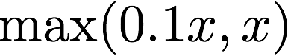
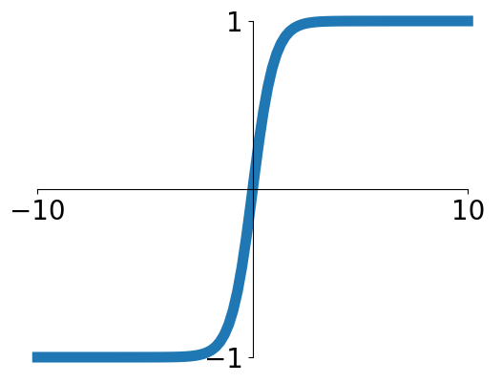
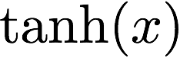
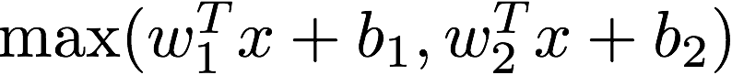
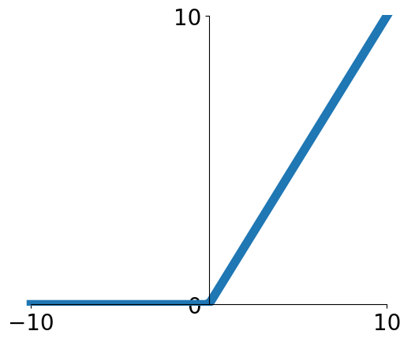
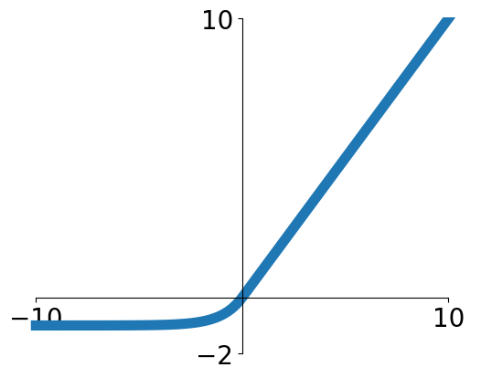
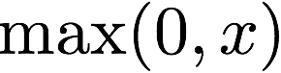
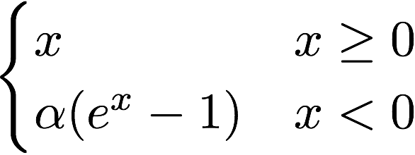
Activation functions
Sigmoid
Leaky ReLU
tanh
Maxout
ReLU
ELU
Slide Credit: Fei-Fei Li, Justin Johnson, Serena Yeung, CS 231n

Slide 23


Neural networks: Architectures
“3-layer Neural Net”, or
“2-hidden-layer Neural Net”
“2-layer Neural Net”, or
“1-hidden-layer Neural Net”
“Fully-connected” layers
Slide Credit: Fei-Fei Li, Justin Johnson, Serena Yeung, CS 231n

Slide 24

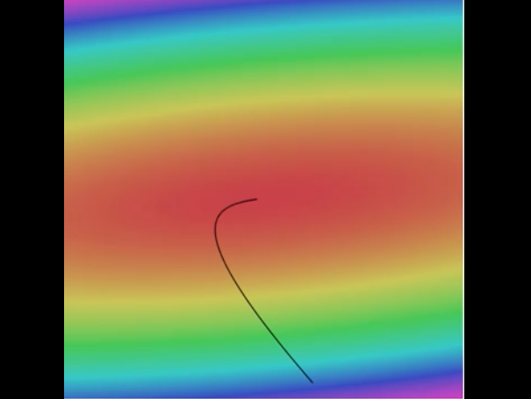

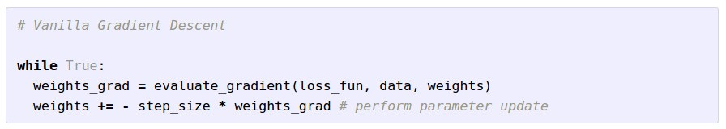
Optimization
Landscape image is CC0 1.0 public domain
Walking man image is CC0 1.0 public domain
Slide Credit: Fei-Fei Li, Justin Johnson, Serena Yeung, CS 231n
Notes:
Iteratively take steps in direction of steepest descent to get to point of lowest loss

Slide 25
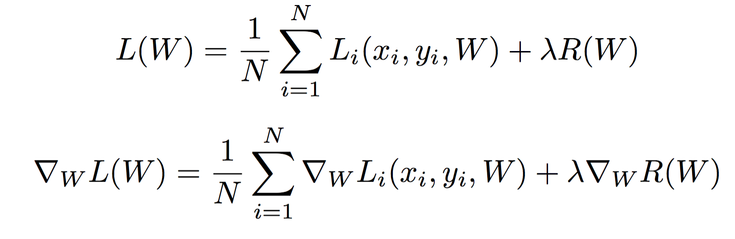
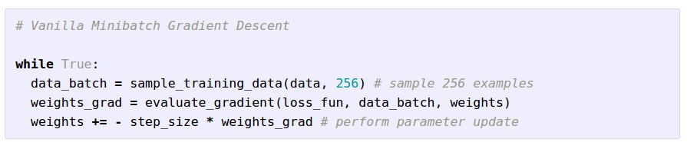
Stochastic Gradient Descent (SGD)
Full sum expensive when N is large!
Approximate sum using a minibatch of examples
32 / 64 / 128 common
Slide Credit: Fei-Fei Li, Justin Johnson, Serena Yeung, CS 231n

Slide 26
How do we compute gradients?
Manual Differentiation
Symbolic Differentiation
Numerical Differentiation
Automatic Differentiation
Forward mode AD
Reverse mode AD
aka “backprop”

Slide 28
Matrix/Vector Derivatives Notation

Slide 29
Matrix/Vector Derivatives Notation

Slide 30
Vector Derivative Example

Slide 31
Extension to Tensors

Slide 32
Chain Rule: Composite Functions

Slide 33
Chain Rule: Scalar Case

Slide 34
Chain Rule: Vector Case

Slide 35
Chain Rule: Jacobian view

Slide 36
Plan for Today
Computational Graphs
Notation + example
Computing Gradients
Forward mode vs Reverse mode AD

Slide 37
How do we compute gradients?
Manual Differentiation
Symbolic Differentiation
Numerical Differentiation
Automatic Differentiation
Forward mode AD
Reverse mode AD
aka “backprop”

Slide 38
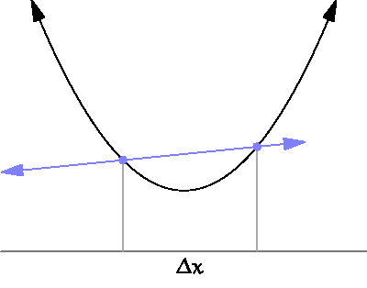
By Brnbrnz (Own work) [CC BY-SA 4.0 (http://creativecommons.org/licenses/by-sa/4.0)]

Slide 39
current W:
[0.34,
-1.11,
0.78,
0.12,
0.55,
2.81,
-3.1,
-1.5,
0.33,…]
loss 1.25347
gradient dW:
[?,
?,
?,
?,
?,
?,
?,
?,
?,…]
Slide Credit: Fei-Fei Li, Justin Johnson, Serena Yeung, CS 231n

Slide 40
current W:
[0.34,
-1.11,
0.78,
0.12,
0.55,
2.81,
-3.1,
-1.5,
0.33,…]
loss 1.25347
W + h (first dim):
[0.34 + 0.0001,
-1.11,
0.78,
0.12,
0.55,
2.81,
-3.1,
-1.5,
0.33,…]
loss 1.25322
gradient dW:
[?,
?,
?,
?,
?,
?,
?,
?,
?,…]
Slide Credit: Fei-Fei Li, Justin Johnson, Serena Yeung, CS 231n

Slide 41
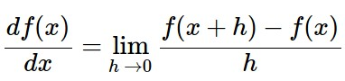
current W:
[0.34,
-1.11,
0.78,
0.12,
0.55,
2.81,
-3.1,
-1.5,
0.33,…]
loss 1.25347
W + h (first dim):
[0.34 + 0.0001,
-1.11,
0.78,
0.12,
0.55,
2.81,
-3.1,
-1.5,
0.33,…]
loss 1.25322
gradient dW:
[-2.5,
?,
?,
?,
?,
?,
?,
?,
?,…]
(1.25322 - 1.25347)/0.0001
= -2.5
Slide Credit: Fei-Fei Li, Justin Johnson, Serena Yeung, CS 231n

Slide 42
current W:
[0.34,
-1.11,
0.78,
0.12,
0.55,
2.81,
-3.1,
-1.5,
0.33,…]
loss 1.25347
W + h (second dim):
[0.34,
-1.11 + 0.0001,
0.78,
0.12,
0.55,
2.81,
-3.1,
-1.5,
0.33,…]
loss 1.25353
gradient dW:
[-2.5,
?,
?,
?,
?,
?,
?,
?,
?,…]
Slide Credit: Fei-Fei Li, Justin Johnson, Serena Yeung, CS 231n

Slide 43
current W:
[0.34,
-1.11,
0.78,
0.12,
0.55,
2.81,
-3.1,
-1.5,
0.33,…]
loss 1.25347
W + h (second dim):
[0.34,
-1.11 + 0.0001,
0.78,
0.12,
0.55,
2.81,
-3.1,
-1.5,
0.33,…]
loss 1.25353
gradient dW:
[-2.5,
0.6,
?,
?,
?,
?,
?,
?,
?,…]
(1.25353 - 1.25347)/0.0001
= 0.6
Slide Credit: Fei-Fei Li, Justin Johnson, Serena Yeung, CS 231n

Slide 44
current W:
[0.34,
-1.11,
0.78,
0.12,
0.55,
2.81,
-3.1,
-1.5,
0.33,…]
loss 1.25347
W + h (third dim):
[0.34,
-1.11,
0.78 + 0.0001,
0.12,
0.55,
2.81,
-3.1,
-1.5,
0.33,…]
loss 1.25347
gradient dW:
[-2.5,
0.6,
?,
?,
?,
?,
?,
?,
?,…]
Slide Credit: Fei-Fei Li, Justin Johnson, Serena Yeung, CS 231n

Slide 45
current W:
[0.34,
-1.11,
0.78,
0.12,
0.55,
2.81,
-3.1,
-1.5,
0.33,…]
loss 1.25347
W + h (third dim):
[0.34,
-1.11,
0.78 + 0.0001,
0.12,
0.55,
2.81,
-3.1,
-1.5,
0.33,…]
loss 1.25347
gradient dW:
[-2.5,
0.6,
0,
?,
?,
?,
?,
?,
?,…]
(1.25347 - 1.25347)/0.0001
= 0
Slide Credit: Fei-Fei Li, Justin Johnson, Serena Yeung, CS 231n

Slide 46
Numerical vs Analytic Gradients
Numerical gradient: slow :(, approximate :(, easy to write :)
Analytic gradient: fast :), exact :), error-prone :(
In practice: Derive analytic gradient, check your implementation with numerical gradient. This is called a gradient check.
Slide Credit: Fei-Fei Li, Justin Johnson, Serena Yeung, CS 231n

Slide 47
How do we compute gradients?
Manual Differentiation
Symbolic Differentiation
Numerical Differentiation
Automatic Differentiation
Forward mode AD
Reverse mode AD
aka “backprop”

Slide 48
Chain Rule: Vector Case

Slide 49
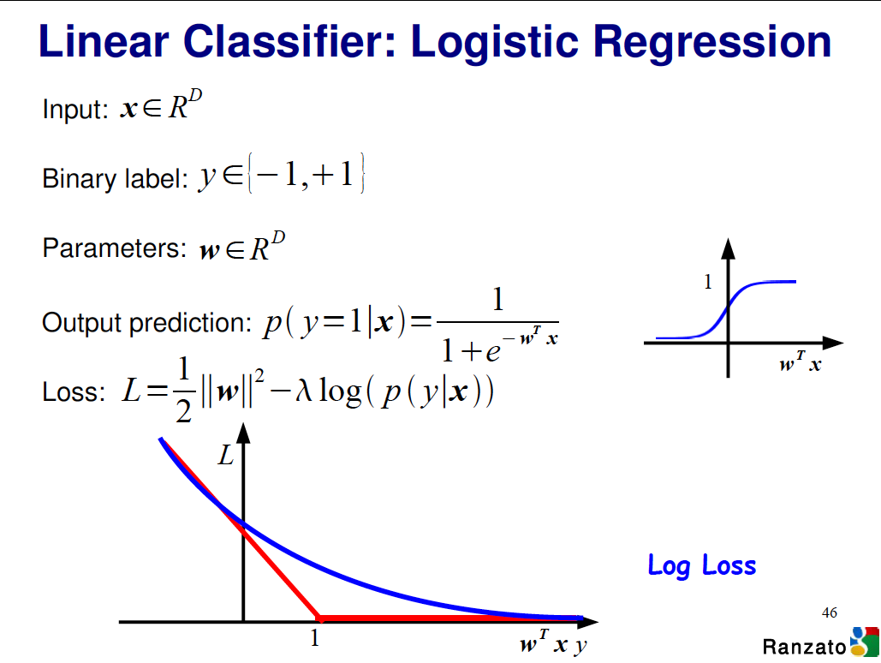

Slide 50
Logistic Regression Derivatives

Slide 51

Convolutional network (AlexNet)
input image
weights
loss
Figure copyright Alex Krizhevsky, Ilya Sutskever, and Geoffrey Hinton, 2012. Reproduced with permission.
Slide Credit: Fei-Fei Li, Justin Johnson, Serena Yeung, CS 231n
Notes:
Becomes very useful when we work with complex functions

Slide 52
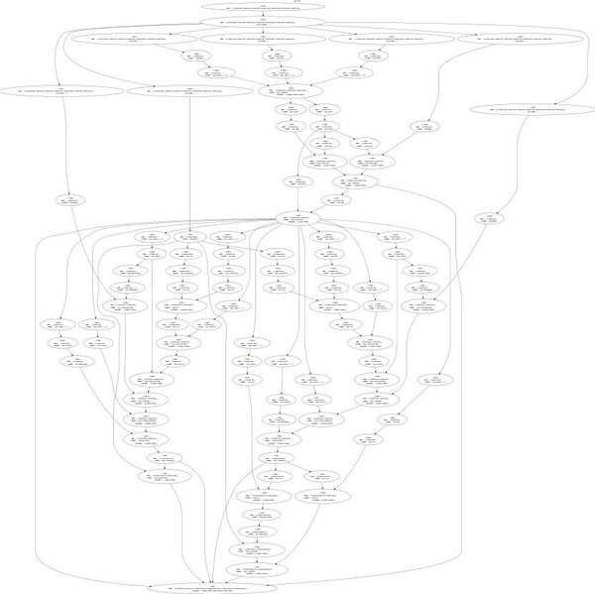
Neural Turing Machine
input image
loss
Figure reproduced with permission from a Twitter post by Andrej Karpathy.
Slide Credit: Fei-Fei Li, Justin Johnson, Serena Yeung, CS 231n
Notes:
Things get even crazier

Slide 53
Neural Turing Machine
Figure reproduced with permission from a Twitter post by Andrej Karpathy.
Slide Credit: Fei-Fei Li, Justin Johnson, Serena Yeung, CS 231n

Slide 54
Chain Rule: Vector Case

Slide 55
Chain Rule: Jacobian view

Slide 56
Chain Rule: Long Paths

Slide 57
Chain Rule: Long Paths

Slide 58
Chain Rule: Long Paths

Slide 59
current W:
[0.34,
-1.11,
0.78,
0.12,
0.55,
2.81,
-3.1,
-1.5,
0.33,…]
loss 1.25347
gradient dW:
[-2.5,
0.6,
0,
0.2,
0.7,
-0.5,
1.1,
1.3,
-2.1,…]
dW = ...
(some function data and W)
Slide Credit: Fei-Fei Li, Justin Johnson, Serena Yeung, CS 231n

Slide 60
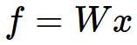

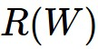
Computational Graph
x
*
s (scores)
hinge loss
+
L
W
R
Slide Credit: Fei-Fei Li, Justin Johnson, Serena Yeung, CS 231n
Notes:
How to compute the analytic gradient for arbitrarily complex functions using frame called computational graph
Can use computational graph to represent any function, where the nodes of the graph are steps of computation that we go through
Linear classifier example
Advantage is that once we express a function using a computational graph, can use a technique called backpropagation which recursively uses the chain rule to efficient compute gradient

Slide 61
Computational Graph
Any DAG of differentiable modules is allowed!
Slide Credit: Marc'Aurelio Ranzato

Slide 62
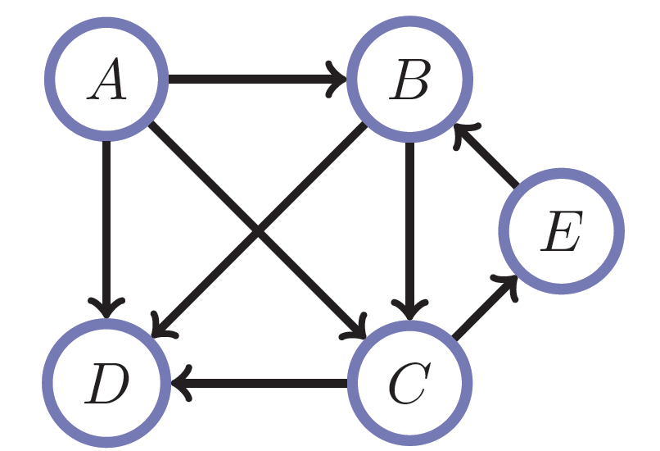
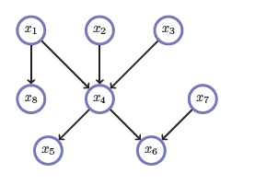
Directed Acyclic Graphs (DAGs)
Exactly what the name suggests
Directed edges
No (directed) cycles
Underlying undirected cycles okay

Slide 63
Directed Acyclic Graphs (DAGs)
Concept
Topological Ordering

Slide 64
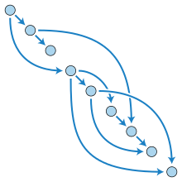
Directed Acyclic Graphs (DAGs)

Slide 65
Computational Graphs
Notation #1

Slide 66
Computational Graphs
Notation #2

Slide 67
Example

Slide 68
Example
+
sin( )
*
x₁
x₂

Slide 69
HW0

Slide 70
HW0 Submission by Samyak Datta

Slide 72
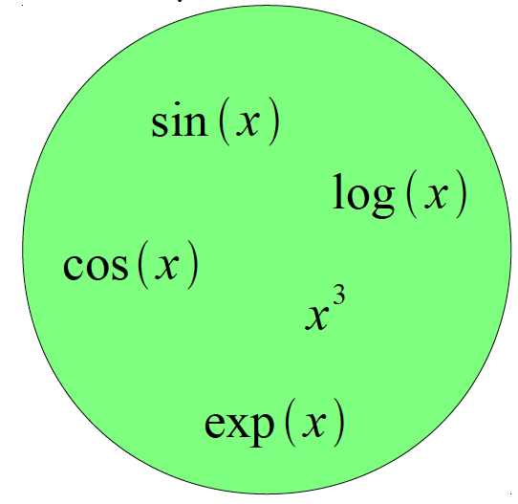
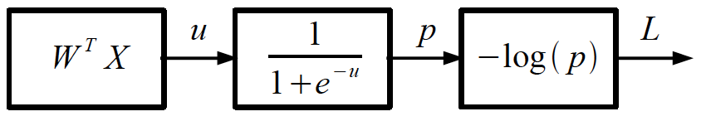
Logistic Regression as a Cascade
Given a library of simple functions
Compose into a
complicate function
Slide Credit: Marc'Aurelio Ranzato, Yann LeCun

Slide 73
Forward mode vs Reverse Mode
Key Computations

Slide 74
Forward mode AD
g
Notes:
What we’re doing in backprop is we have all these nodes in our computational graph, each node only aware of immediate surroundings
at each node have ...

Slide 75
Reverse mode AD
g
Notes:
What we’re doing in backprop is we have all these nodes in our computational graph, each node only aware of immediate surroundings
at each node have ...

Slide 76
Example: Forward mode AD
+
sin( )
*
x₁
x₂

Slide 77
Example: Forward mode AD
+
sin( )
*
x₁
x₂

Slide 78
Example: Forward mode AD
+
sin( )
*
x₁
x₂

Slide 79
Example: Forward mode AD
+
sin( )
*
x₁
x₂

Slide 80
Example: Reverse mode AD
+
sin( )
*
x₁
x₂

Slide 81
Example: Reverse mode AD
+
sin( )
*
x₁
x₂

Slide 82
Example: Reverse mode AD
+
sin( )
*
x₁
x₂

Slide 83
Forward mode vs Reverse Mode
What are the differences?
+
+
sin( )
*
sin( )
*
x₁
x₂
x₁
x₂

Slide 84
Forward mode vs Reverse Mode
What are the differences?
Which one is more memory efficient (less storage)?
Forward or backward?

Slide 85
Forward mode vs Reverse Mode
What are the differences?
Which one is more memory efficient (less storage)?
Forward or backward?
Which one is faster to compute?
Forward or backward?

